Slide 1
ChIP-seq module
BD2K Course 2018
Y. Ada Zhan

Slide 2
Introduction

Slide 3
Learn from RNA-Seq
Normal
Cancer
Differential Gene Expression
What may cause the differences?
Steve Munger, 2017

Slide 4
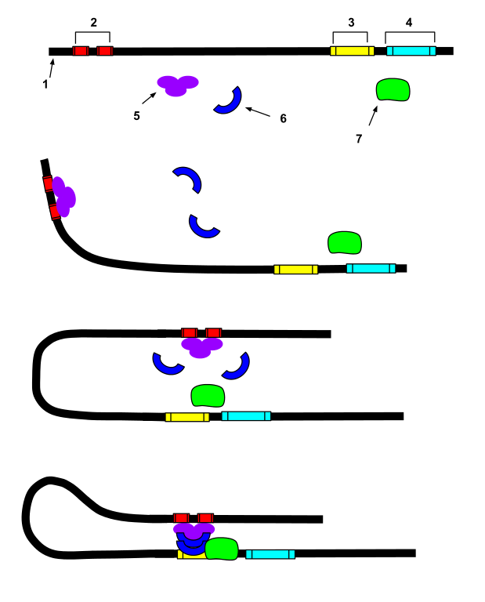
What can go wrong or be different?
1. DNA 2. Enhancer 3. Promoter 4. Gene 5. Transcription Activator Protein 6. Mediator Protein 7. RNA Polymerase
Structure variation (mutation,deletion, translocation etc. in DNA sequences)
Chemical modifications on DNA (methylation, acetylation, etc.)
Chemical modifications on histone

Slide 6
ChIP-seq
Chromatin ImmunoPrecipitation followed by Sequencing
Work on proteins that interact with DNA
Get the DNA sequences that are bound by the protein of interest
Explore how genes are regulated
Applications:
To detect interesting regions in genome at base-pair resolution for
DNA-binding proteins, e.g. transcription factor, RNAPII, etc
Histone modifications → status of enhancers

Slide 7
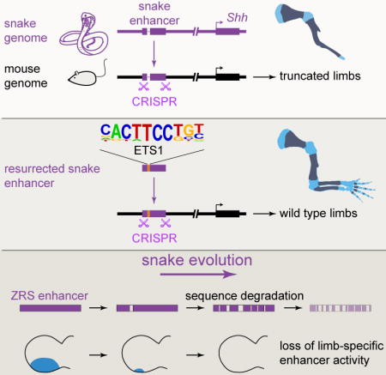
Example on enhancer
ChIP-Seq can help find enhancers
Other techniques, like eQTL, Hi-C or ChIA-PET, are required to identify the interactions between particular enhancers and genes.
Kvon et. al, cell 2016

Slide 8
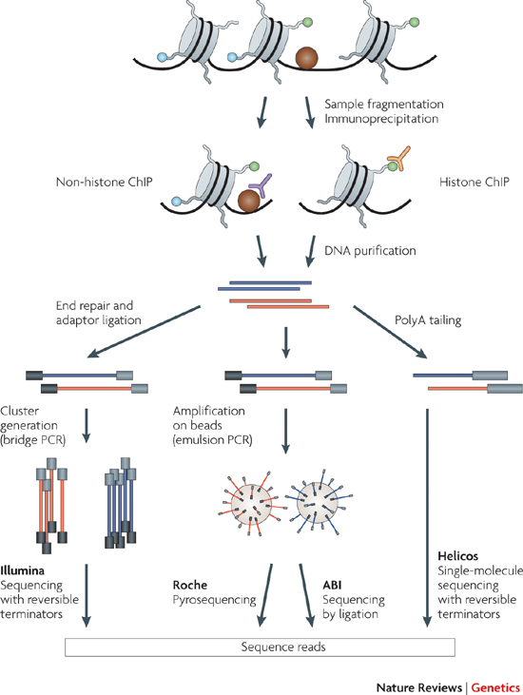
ChIP-seq
Experiment

Slide 9
Experimental Considerations
Antibodies: High sensitivity and specificity
Cell number: More cells, better signal-to-noise (typically 10⁶ to 10⁷ cells)
Controls: To remove background noise
IgG (Reads are only informative if the ChIP hasn't worked.)
Input Chromatin (sonicated / Mnase etc)
Genomic library - everywhere equally
Technical issues can cause variation
Replicates:
B. Kidder et al. Nature Immunology 12, 918-922 (2011)
Notes:
Chromatin fragmentation: ~150 to 300 bp (after sonication or nuclease digestion)
Library construction and sequencing: at 22C, avoid overamplified PCR, 25 bp – 66% coverage, 30 or 35 bp – 70.9% or 74.1% mappability

Slide 10
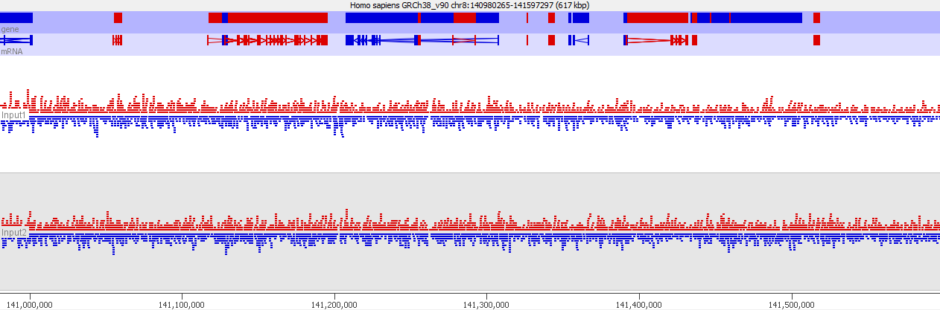


Examine controls
Does the coverage look even
If there are multiple inputs to do they look similar

Slide 11
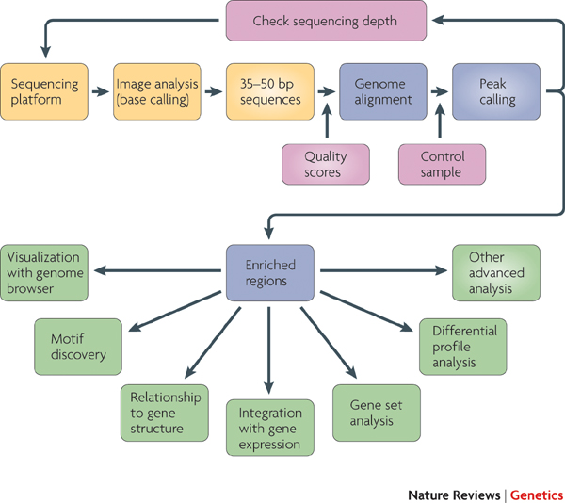
Overview of ChIP-seq analysis
Up to 100bp
Notes:
Recommended coverage X reads: 10-14M (sharp peaks); 20-40M (broad marks)
Encode pipeline encourages > 50bp
For 35 – 50 bp bowtie works faster, for 50bp + bowtie 2 is better.

Slide 12
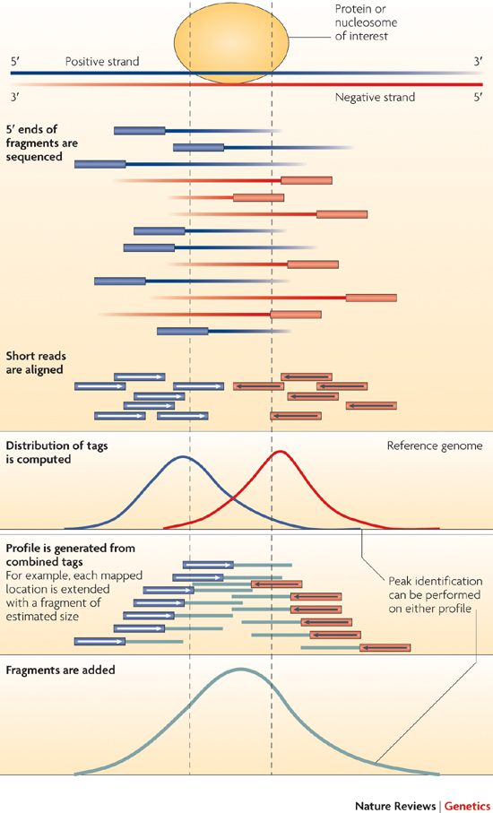
Sequence Alignment
Notes:
Alignment for ChIP–seq should allow for a small number of mismatches due to sequencing errors, SNPs and indels or the difference between the genome of interest and the reference genome.
Reads mapped to multiple sites ('multi-reads') are usually discarded during 'normal' analysis. Consequently, peaks in highly repetitive regions are overlooked.

Slide 13
Sequence Alignment
Bowtie (35 – 50 bp)
Bowtie2 (50 – 100 bp, no upper limit actually)
BWA (different algorithms for shorter and longer sequences than 70bp)
Others: MAQ, ELAND, …

Slide 14
Peak calling Identify enriched regions above controls
Alignment
Stranded peaks
Extended tag mapping
Combined profile
Notes:
Tag? Compy number?

Slide 15
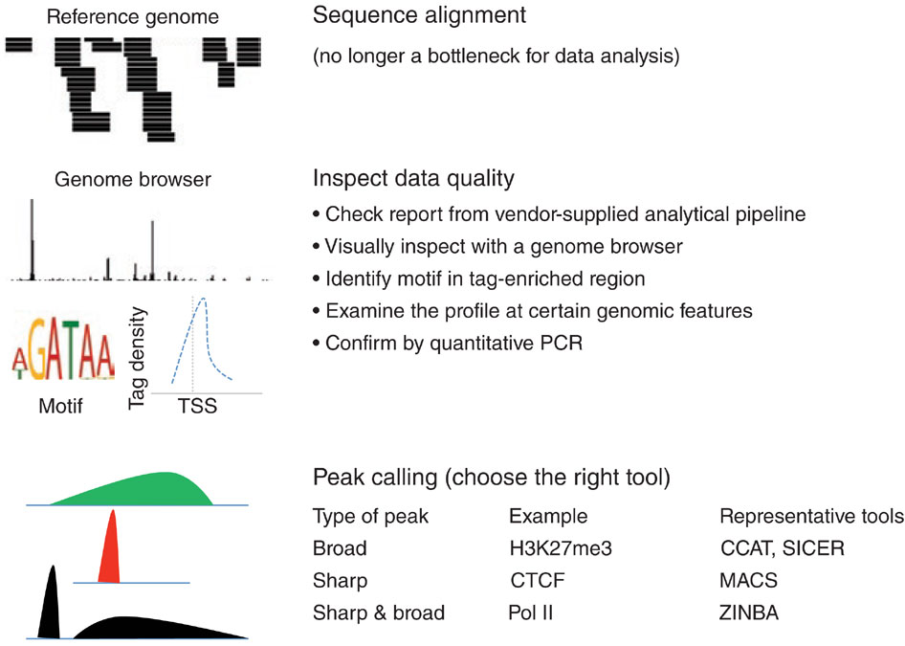
Peak calling Software
B. Kidder et al. Nature Immunology 12, 918-922 (2011)

Slide 16
Peak calling Software used in Encode pipeline

Slide 17
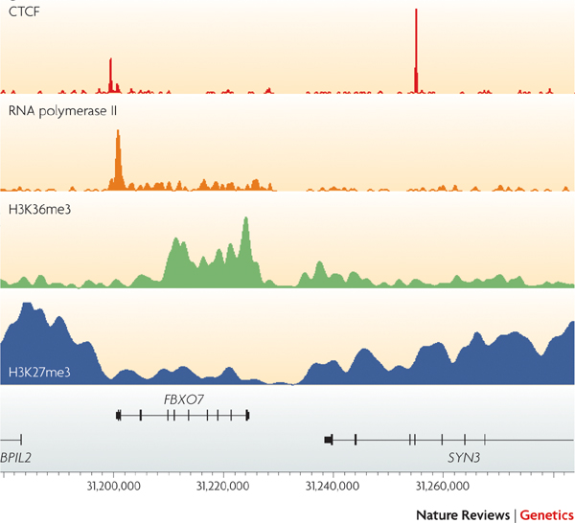
ChIP-seq profile

Slide 18
After peak calling
Motif analysis (MEME, HOMER, …)
Integrative analysis with expression data
Differential binding
Peak annotation
…

Slide 19
Motif analysis

Slide 20
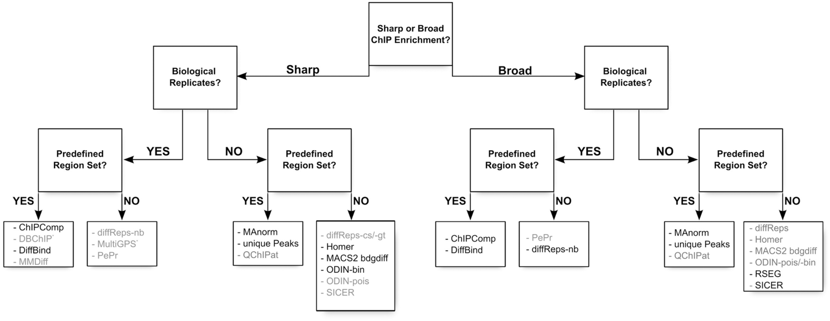
Differential binding
From: A comprehensive comparison of tools for differential ChIP-seq analysis
Brief Bioinform. 2016;17(6):953-966. doi:10.1093/bib/bbv110
Brief Bioinform | © The Author 2016. Published by Oxford University Press.This is an Open Access article distributed under the terms of the Creative Commons Attribution Non-Commercial License (http://creativecommons.org/licenses/by-nc/4.0/), which permits non-commercial re-use, distribution, and reproduction in any medium, provided the original work is properly cited. For commercial re-use, please contact journals.permissions@oup.com
Notes:
Figure 7. Decision tree indicating the proper choice of tool depending on the data set: shape of the signal (sharp peaks or broad enrichments), presence of replicates and presence of an external set of regions of interest. We have indicated in dark the name of the tools that give good results using default settings, and in gray the tools that would require parameter tuning to achieve optimal results: some tools suffer from an excessive number of DR (PePr, ODIN-pois), an insufficient number of DR (QChIPat, MMDiff, DBChIP) or from an imprecise definition of the DR for sharp signal (SICER, diffReps-nb). *MultiGPS has been explicitly developed for transcription factor ChIP-seq.
20

Slide 21
Correlation between different binding factors

Slide 22
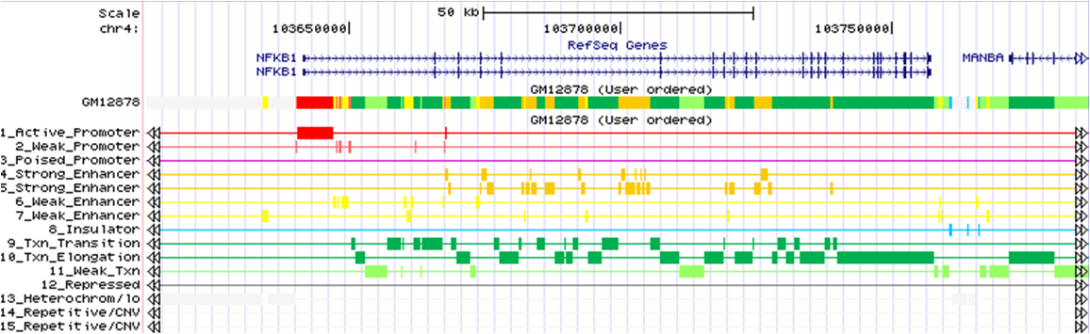
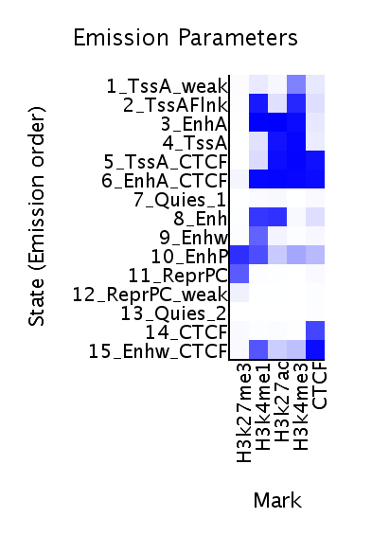
Chromatin state
ChromHMM: http://compbio.mit.edu/ChromHMM/

Slide 23
Interactive ChIP-Seq analysis server
http://chipseek.cgu.edu.tw

Slide 24
For command line user – Anaconda and bioconda
Anaconda (package management platform) https://anaconda.org
Bioconda (package reporsitory for bioinformatics) https://bioconda.github.io
Deeptools http://deeptools.readthedocs.io/en/develop/

Slide 25
Data from database
Encode (https://www.encodeproject.org)
modEncode (http://www.modencode.org/publications/about/index.shtml)
Roadmap (http://www.roadmapepigenomics.org)
ArrayExpress (http://www.ebi.ac.uk/arrayexpress/)
------
GENCODE (human and mouse genome)
Notes:
Demo Encode usage

Slide 26
Hands on Work

Slide 27
What we will do?
Objective: Perform a basic ChIP-seq pipeline
In terminal:
Quality check (FASTQC: check the quality of raw sequencing data in fastq format)
Mapping (bowtie: align sample sequences to the reference genome)
Peak calling (MACS2: locate immuno-enriched regions)
On MEME online server
Motif analysis (MEME-ChIP: identify the binding motifs)

Slide 28
Tools
Software | Version | Usage
fastqc | 0.11.3 | Quality checking
Bowtie | 0.12.8 | mapping
Samtools | 1.3.1 | SAM, BAM file manipulation
MACS2 | 2.0.10.20120913 | Peak calling
bedtools | 2.26.0 | Bed file manipulation
Note:
You may install the software through bioconda
MACS2 requires python2.7.X
Check software dependencies on their installation page on-line

Slide 29
Datasets
Assay: ChIP-seq
Target: CTCF
Biosample: Homo Sapiens GM12878 (A lymphoblastoid cell line produced from the blood of a female donor with northern and western European ancestry by EBV transformation)
Sample type: DNA
Chromosome: Chr1
Lab: Bradley Bernstein, Broad
Source: encodeproject.org
Platform: Illumina Genome Analyzer
ENCODE accession id:
ENCFF000ARP (sample) -> GM12878_CTCF_chr1.fastq
ENCFF000ARK (control) -> GM12878_control_chr1.fastq

Slide 30
Getting help
fastqc --help
bowtie -h
samtools or samtools <command>
macs2 -h

Slide 31
Check where you are:
pwd
Find out what are in the directory:
ls
Go to ‘ChIPseq’ folder:
cd ChIPseq
Check what’s in the box: ls
Examine files: less filename or cat filename
Take a look at two files: readme.txt and workflow.sh
readme.txt : describes the data structure in this folder
workflow.sh : contains all the commands for this practice

Slide 32
Check the sequencing quality
# Go the data folder if you are not there:
cd ChIPseq
# Perform fastqc quality check:
fastqc GM12878_control_chr1.fastq
fastqc GM12878_CTCF_chr1.fastq
# Check output files
ls
(You will find .zip and .html files for each .fastq. Download .html files and open them in your browser)

Slide 33
Index the genome
# To make the alignment more memory efficient, bowtie will index the genome first.
# The reference genome is the chromosome 1 of human genome build GRCh38
bowtie-build hg38/GRCh38.chr1.fa hg38/GRCh38.chr1

Slide 34
Sequence alignment
# learn bowtie options
bowtie –h
# map to reference genome
bowtie -m 1 -S ./hg38/GRCh38.chr1 GM12878_control_chr1.fastq \
> GM12878_control_chr1.sam
bowtie -m 1 -S ./hg38/GRCh38.chr1 GM12878_CTCF_chr1.fastq \
> GM12878_CTCF_chr1.sam
# Take a look at the first 5 lines of the output
head –n 5 GM12878_CTCF_chr1.sam

Slide 35
Compress SAM
# Learn samtools view options
samtools view
# Compress SAM to BAM file to save storage
samtools view -bSo GM12878_control_chr1.bam \
GM12878_control_chr1.sam
samtools view -bSo GM12878_CTCF_chr1.bam \
GM12878_CTCF_chr1.sam

Slide 36
Index BAM
# Index the BAM files for IGV visualization in two steps
## sort the alignment according to chromosome position
samtools sort GM12878_control_chr1.bam \ GM12878_control_chr1.sorted
samtools sort GM12878_CTCF_chr1.bam \
GM12878_CTCF_chr1.sorted
## index the sorted files
samtools index GM12878_control_chr1.sorted.bam
samtools index GM12878_CTCF_chr1.sorted.bam
Note: make sure the sorted.bam and .bai index files in the same directory for IGV loading

Slide 37
Peak calling
# Learn macs2
macs2 –h
# Identify peak enrichment
macs2 callpeak -t GM12878_CTCF_chr1.sorted.bam \
-c GM12878_control_chr1.sorted.bam \
-f BAM -g 175000000 -n GM12878_CTCF_chr1 -B -q 0.01
The output files description can be found on MACS2 page :
https://github.com/taoliu/MACS
The R script is one output of macs2.
The output .bed file can be loaded to IGV directly.

Slide 38
Motif analysis
# summit files include the estimation of peak summit at single base level
# extend summits 100bp on both directions
bedtools slop -i GM12878_CTCF_chr1_summits.bed \
-g hg38/GRCh38.chr1.size -b 100 \
> GM12878_CTCF_chr1_summits_ext.bed
# get sequences for the extended summit regions (i.e. fasta)
bedtools getfasta -fi hg38/GRCh38.chr1.fa \
-bed GM12878_CTCF_chr1_summits_ext.bed \
-fo GM12878_CTCF_chr1_summits_ext.fa

Slide 39
Motif analysis using MEME
Go to site: http://meme-suite.org/tools/meme-chip

Slide 40
ChIPseek – an online tool
Go to site: http://chipseek.cgu.edu.tw/analysis_form.php
Follow the steps
Upload BED file
Obtained from peak calling

